Slide 1


Campaign Optimization
Prepared by:
Yazan akkad

Slide 2
Summary
Objective:
Place campaign between break interval of TV shows
Constrain:
Do not exceed total airtime in a Slot
Target audience matching
Average reach for High priority should be higher than Medium, and Medium higher than Low

Slide 3
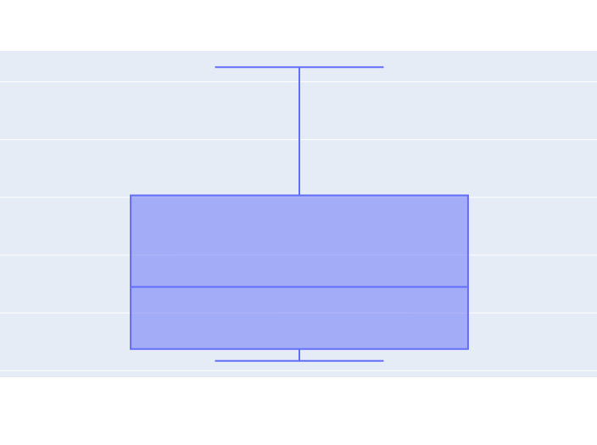
Methodology
Box and whisker plot was used to visualize average reach distribution.
To maintain L<M<H, average reach quartile analysis was used as a proxy to create priority feature for schedule data.
MAX
Q3
Median
Q1
MIN

Slide 4

Findings
Priority Level | Total Reach
H | 64,716.86
M | 19,765.61
L | 5,747.07
Target Audience | Slot Duration | Promo Duration
Female | 01:00:13 | 00:04:00
Female/Male | 11:15:00 | 00:25:00
Total promo duration did not exceed airtime at a given slot.

